Slide 1
LUTS
Cordula Sabellek

Slide 2
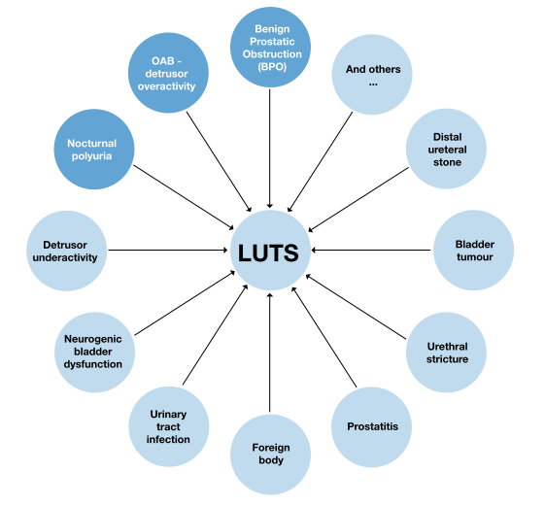
LUTS
“Lower urinary tract symptoms”
40% of the older men
Multiple causes for this complex of symptoms
One of them is benign prostate obstruction (BPO)
Term: BPH -> benign prostate hyperplasia refers only to the Histopathology and is obsolete
Notes:
-

Slide 3
Filling (storage) or irritative symptoms
Increased frequency of urination
Increased urgency of urination
Urge incontinence
Excessive passage of urine at night
Voiding or obstructive symptoms
Poor stream (unimproved by straining)
Hesitency
Terminal dribbling
Incomplete voiding, residual urine volume
Acute urinary retention
Overflow incontinence

Slide 4
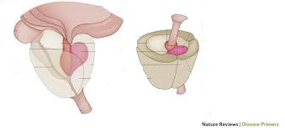
BPO
Transitional zone

Slide 5
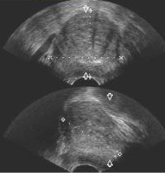
Diagnostic
Medical history
Physical examination with DRE
IPSS
Urine analysis
Lab: PSA, creatinine, electrolytes, full blood count
Sonography: kidneys, bladder, residual urine, prostate size, thickness of bladder muscle
Uroflowmetry

Slide 6
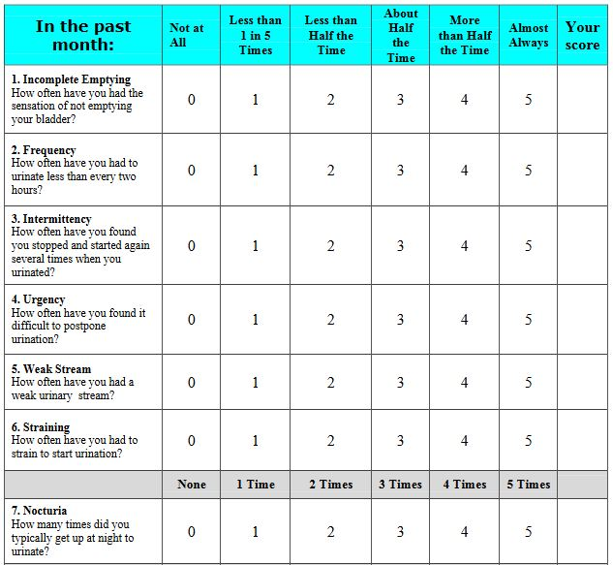
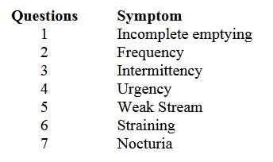
IPSS International prostate symptom score
Mild: <7
Moderate: 8-19
Severe: 20-35

Slide 7
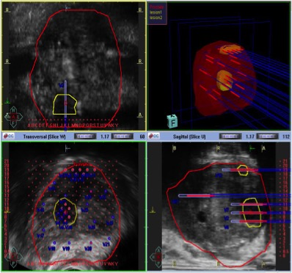
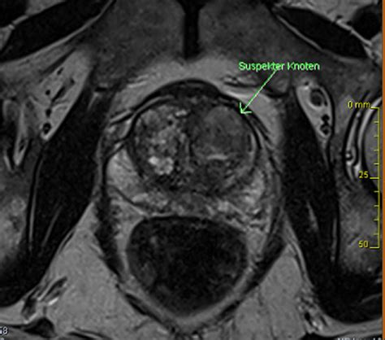
Prostate biopsy
Indicated if signs of prostate cancer
PSA-Elevation, high PSA-Density and suspicious DRE
Rectal, perineal
Sonography-guided, MRI-guided
With special software and navigation-system

Slide 8
Treatment
1. life style change
2. conservative/medical
3. surgical

Slide 9
Treatment
1. Life style Change
2. conservative/medical
Offer to patients with mild to moderate symptoms
α1-Blocker (Tamsulosin)
5α-reductase inhibitor (Finasteride)
Muscarinic receptor antagonist (Oxybutynin)
Phosphodiesterase 5 inhibitor (Sildenafil)
combination

Slide 10
Treatment
1. Life style Change
2. conservative/medical
3. surgical
Offer to patients with severe symptoms or unsuccessful medical treatment
< 80ml TUR-P (monopolar/bipolar)
> 80ml open enucleation (Harris, Millin)
Laserenucleation (Holep)

Slide 11
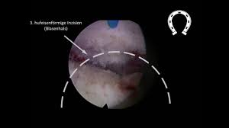
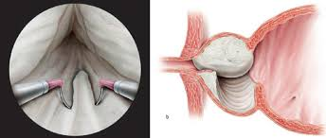
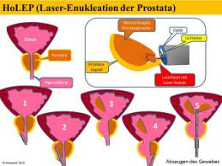
TUR-P vs. Holep

Slide 12
TUR-Syndrome
absorption of the bladder-irrigation during the operation into the prostatic venous sinuses -> fluid overload, disturbed electrolyte balance and hyponatraemia
Neurological: Headache, Nausea and vomiting, confusion, Cerebral edema, Convulsions, Coma
Cardio-respiratory: Bradycardia, Hypo- or hyper- tension, Tachypnoea, Hypoxia, Pulmonary edema
Improve:
-> Irrigation fluid, Operative-time, Anaesthesia, Prostate size, Patient position

